Slide 1
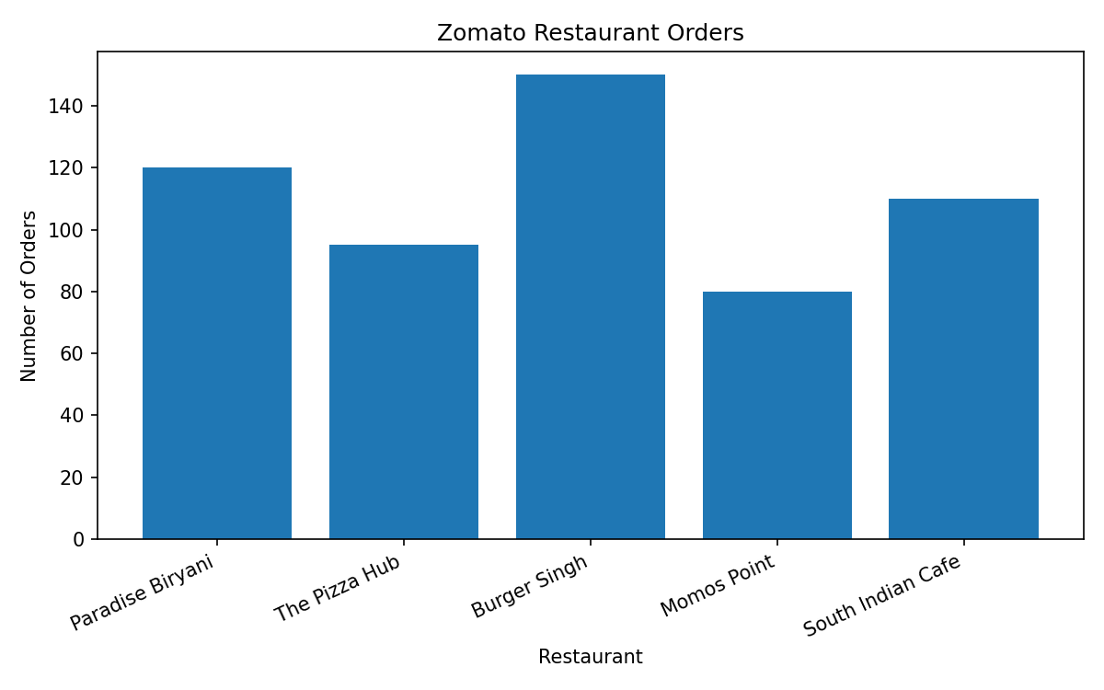
Zomato Restaurant Orders - Embedded PNG Chart

